Slide 1
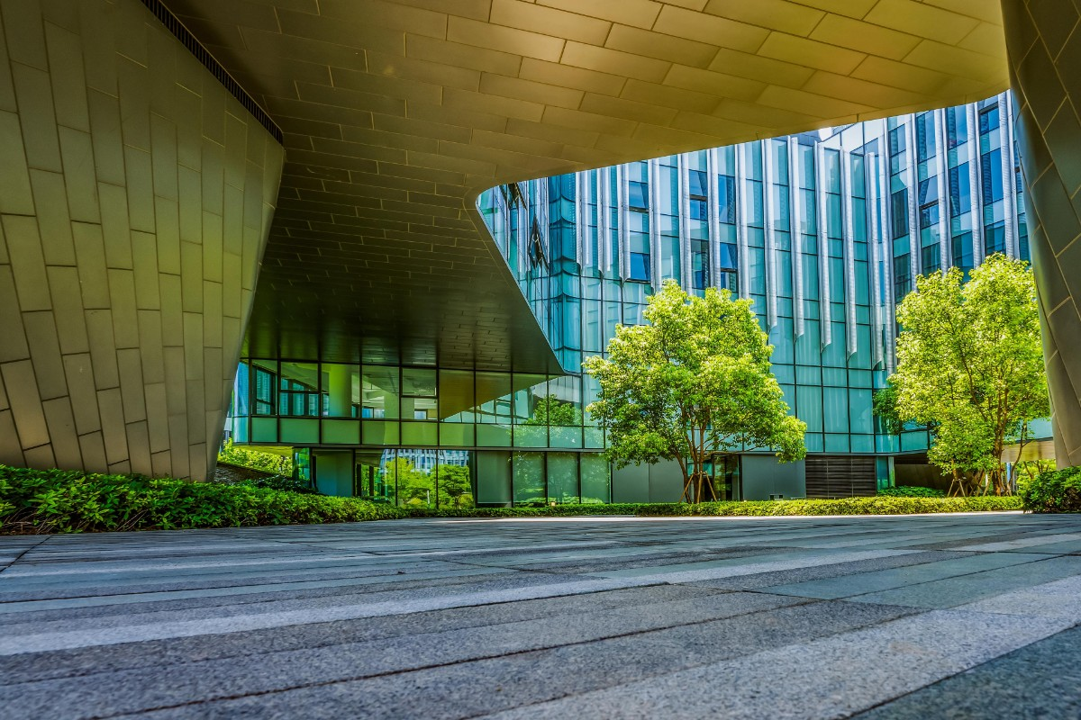
Project NetZero
Let’s ride on the road to net zero and decarbonization
19 November 2021

Slide 2

As you have already noticed that its no longer an option rather an necessity for each one of us to take part in this global transition to a sustainable future. Global Market Leaders, Wealth and Asset managers as well as Investors must play critical role in enabling the transition to a more sustainable future by strengthen environmental disclosures, bring in sustainability governance, Green energy investments along with advancement of the sustainability agenda across the broader economy.
Abstract

Slide 3
Contents
Abstract
Introduction to Project NetZero
Roadmap
Use cases
Team

Slide 4
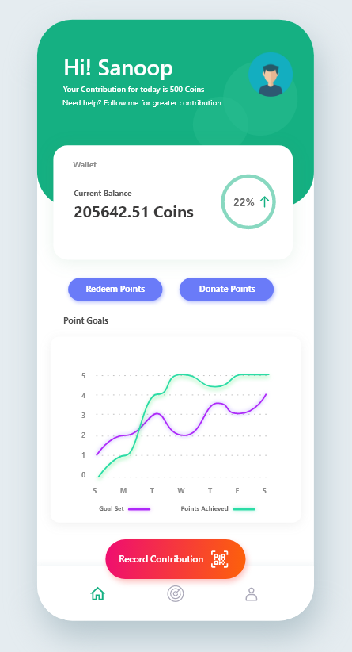
Introduction to Project NetZero
Project NetZero aims to bring in an Global Transparent collaborative reward platform that allows for empirical comparisons at the firm, sector and country level as well as helping to define Sustainable Development Goals, identify best practices and target areas for improvement along with the ways to generate green capital for future green economy development.
Public as well as companies can access this platform through our mobile application and submit their proof of contribution to sustainability. Then our AI engine will ensure the credibility of the submitted proof and generates Carbon Reduction Index(CRI) value. CRI will be used for deriving the crypto tokens (ZeroCarb Coin) through IBM Blockchain. These generated tokens will be available in contributors wallet and these transactions will be shared across the distributed ledger.
Our mobile app provides an Immersive Augmented Reality view of Earth along with various data distributions such as methane, carbon monoxide, oxone, and nitrogen oxide along with related climate change as well as temperature anomalies. Also it gives location based ZeroCarb Coin distribution that can provide a clear indication of overall app usage and peoples live contribution at country level.
In addition to this, we are also envisioning to collaborate with various companies to enable the ZeroCarb coin redemption that will also accelerate their related products and services.

Slide 5











Roadmap
1
Researching & Ideation
3
Prototype Technical Feasibility
5
MVP Planning
7
Phase 1 Development
9
Beta Release
First our team have done market research on the current situation, opportunities, blockers as well as how we can be a valuable contributor.
Based on the inputs from IBM EY Alliance Call for Code enablement sessions along with our technical research we have identified the components needed for the solution.
In this phase based on the input and suggestion from call for code core committee, our team will prioritize the requirements, funding for MVP1 development, UX design etc.
Household can submit Current & Prior month electricity bill. Based on the reduction the system will generate a token in IBM Blockchain
Play store Deployment
Invite more organization and developers to the platform
2
Wireframe Designing
4
Prototyping
6
MVP Development
8
Phase 2 Development
Rapidly we tried to sketch the Interface layout and platform roadmap.
In prototype building phase we created an android app using technologies such Flutter, Sustainability APIs, Unity 3D, ML Kit etc. App will allows the users to submit their contribution and AI engine will read the data for rewarding a dummy coin. Also it gives location based ZeroCarb Coin distribution on AR view of Earth.
Integration of IBM Blockchain
Integration of Machine Learning
Integration of IBM Cloud Foundry/Azure app service
Include more usecase in proof submission category
ML Module fine tuning
<-- Current stage

Slide 6



Use cases
Proof of electricity usage reduction
Proof of renewable energy usage
Proof of Usage of public transport
Proof of Energy saving product purchases
Household
Proof of Purchase of Electric Vehicles
Proof of usage of shared cab/public transport/cycling/walking
Proof of taking part in green initiatives
Workforce
Proof of Investments in Renewal Energy
Proof of collaborating with Green projects
Proof of purchase of recycled products
Accept ZeroCarb Coins in their platforms as acceptance mechanism
Corporates

Slide 7
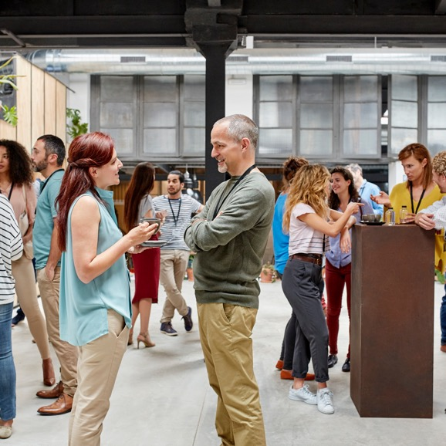

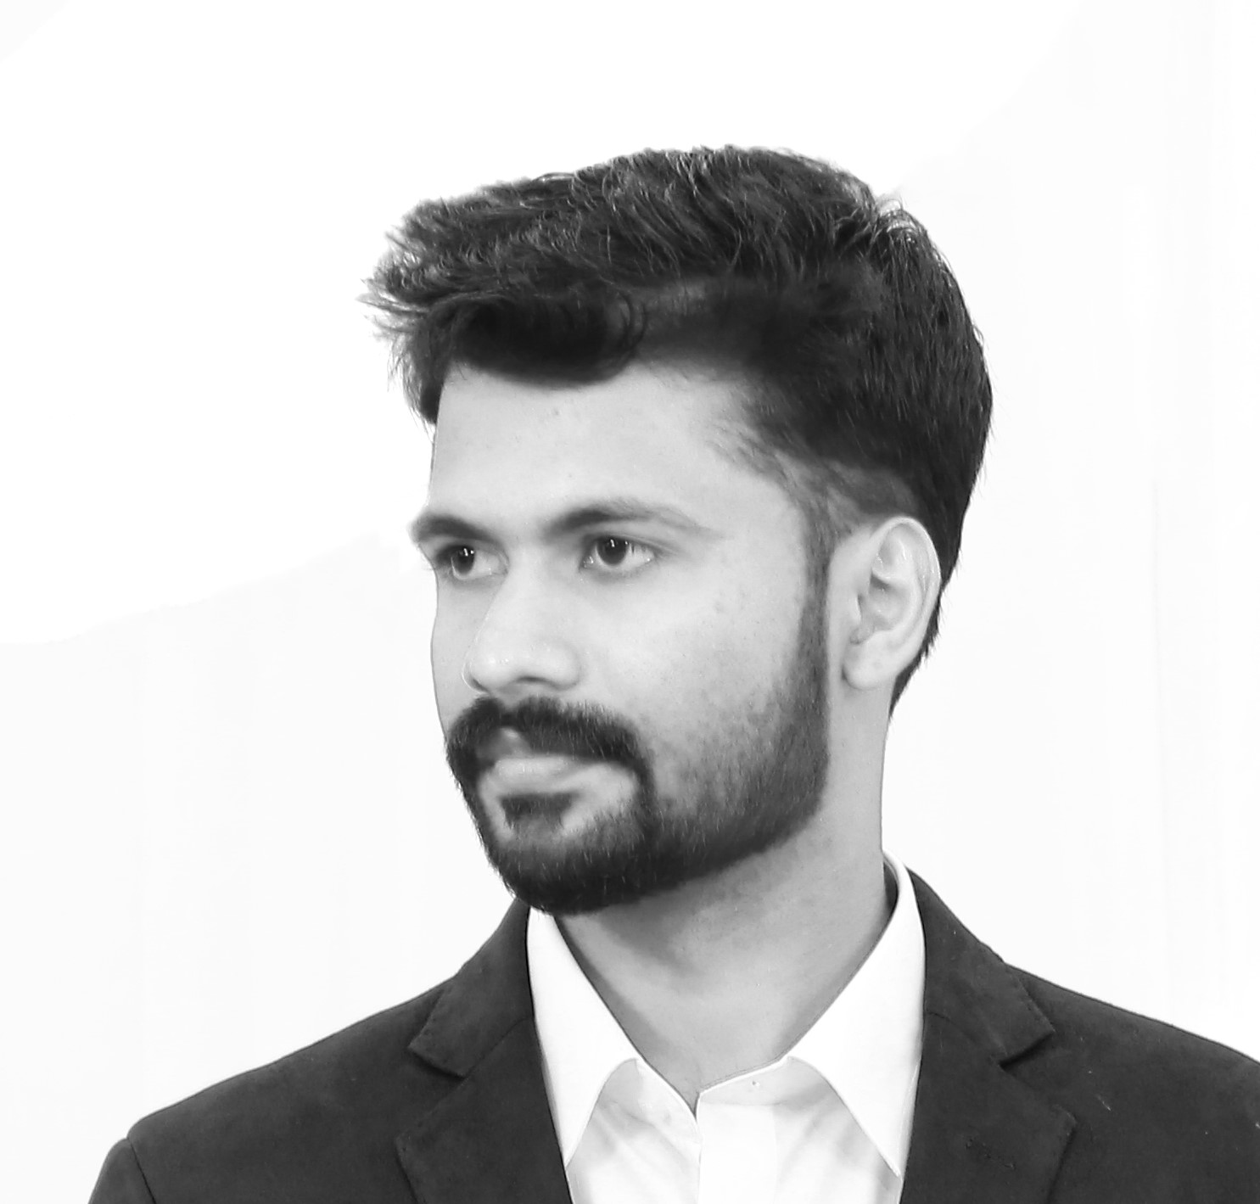



Team
Milan K Raj
Nandu Krishna
Sanoop Surendran
Niji Rajan
Robin Raj SB
Thank You

